Slide 1
Phishing Attack
Computer Security
Hussain Reza and Kaleb Henderson

Slide 2
Introduction
Phishing uses deceptive websites to trick users into revealing sensitive data like passwords and banking info. Because it targets human psychology rather than technical vulnerabilities, it remains a highly effective threat to both individuals and organizations.
This project demonstrates phishing mechanics in a controlled environment and develops a simple prototype system to detect suspicious URLs. By simulating an attack and building a protection mechanism, it integrates both offensive and defensive cybersecurity strategies.

Slide 3
Objective and Tools Used
To demonstrate how a credential harvesting attack operates and how automated URL analysis can identify malicious sites.
Python (Flask)
HTML/CSS
Txt File Logging

Slide 4
How it works?
Deceptive Interface: Using custom HTML to mimic a legitimate banking “Sign On” portal.
Back-end Logic: A Flask server hosts the page and listens for POST requests on the /login route.
Data Capture: The script extracts the username and password variable directly from the submitted form. The “Hook”: After submission, the user sees “login failed. Please try again” masking the thefit and encouraging them to try again.

Slide 5
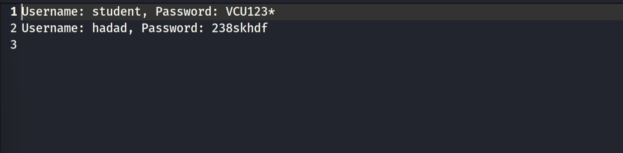
Data Exfiltration
Local Storage: Stolen data is not just processed; it is persisted to a local file named credentials.txt.
Format: Data is appended in a clear, readable format: Username: {username}, Password: {password}
Test Results: Our simulation successfully captured multiple credentials, proving the code’s effectiveness.

Slide 6
Detection Algorithm
Script Overview: detect.py uses a scoring-based heuristic to evaluate the safety of any given URL.
Risk Indicators:
IP Addresses: Flagging URLs that use raw IP numbers instead of registered domain names.
Keyword Analysis: Searching for high-risk terms like “bank,” “verify,” and “secure”.
Structural Red Flags: Analyzing URL length, subdomain counts, and special characters(like @).

Slide 7
Scoring Logic and Results
The Scoring System:
Safe: Score < 2
Suspicious: Score 2-3
Like Phishing: Score >= 4
Test Case: Inputting http://127.0.0.1:5000/login resulted in a “Likely Phishing” classification”
Why it failed: The URL triggered the IP address check (+2) and the suspicious keyword check (+2), hitting the threshold for a high-resk alert.

Slide 8
Testing
Sample URLs were tested:
URL Example | Result
https://www.google.com | Safe
http://192.168.1.5/login-bank | Likely Phishing
http://secure-login-update.com | Suspicious

Slide 9
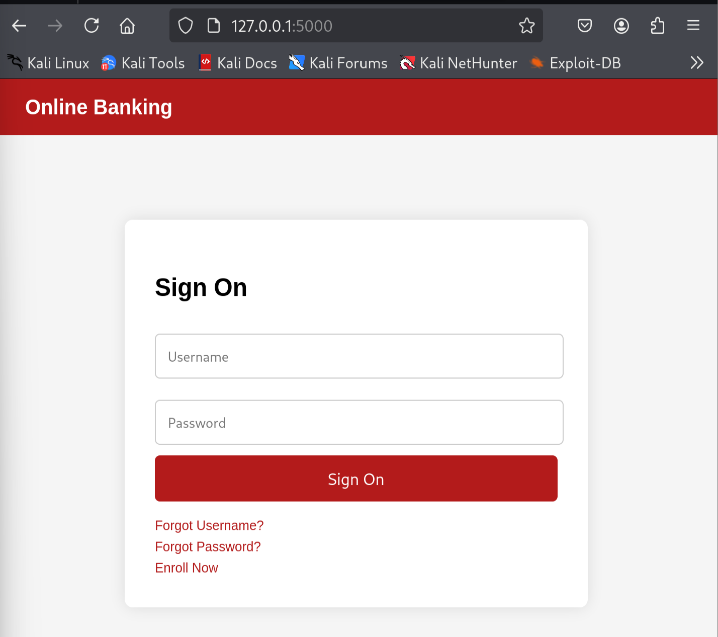
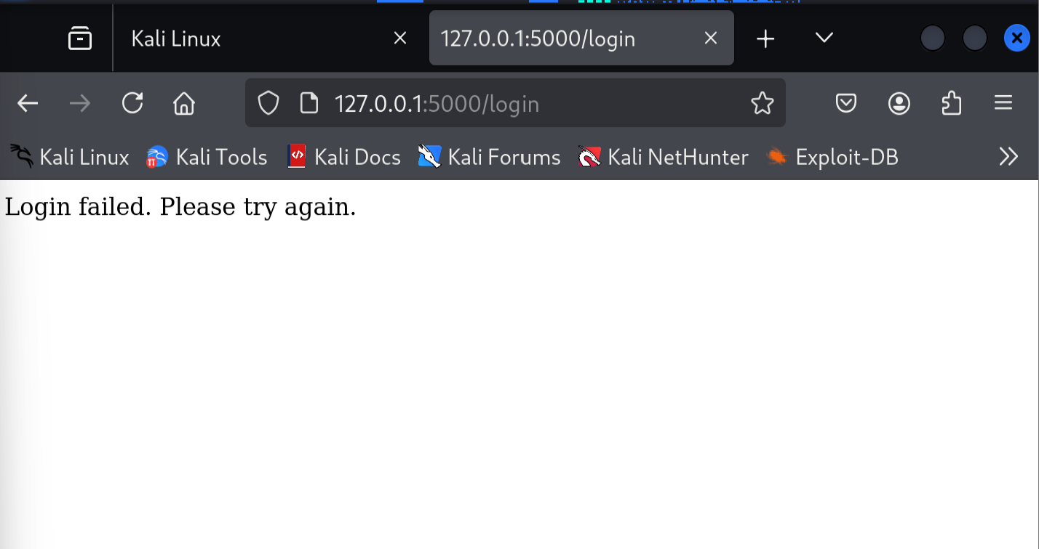
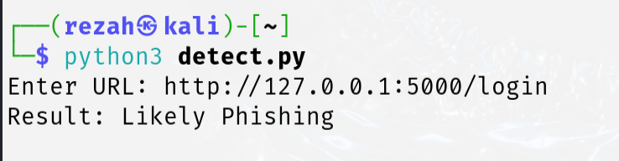

Slide 10
Conclusion & Security Takeways
The Danger of Visuals: A professional looking UI can easily hide malicious back-end code.
Automation is Key: Using scripts like detect.py can provide a first line of defense that doesn't rely on human intuition.
Future Improvements: Enhancing the detection tool with SSL certificate verification and blacklisted domain lookups.

Slide 11
